Slide 1

Basic Details of the Team and Problem Statement
Organization Name : Department of Space, Indian Space Research Organisation (ISRO).
PS Code: SS591
Problem Statement Title: Deep Learning-based Cyclone Intensity estimation using INSAT-3D IR Imagery Team Name: VORTEX Team Leader Name: Mr. Indrashis Paul Institute Code (AISHE): U-0923
Institute Name: VIT Bhopal University
Theme Name: Disaster Management

Slide 2
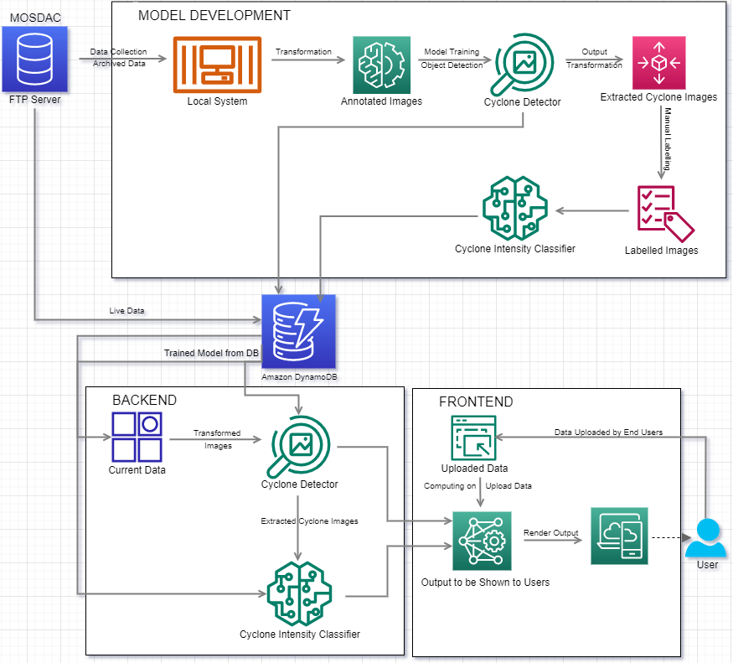
Idea/Approach Details
Our Solution Steps:
Collecting a set of archived Infrared images captured by the INSAT-3D satellite.
Training two State-of-the-Art Vision models: Cyclone Detector and Cyclone Intensity Estimator
With the latest data retrieved from MOSDAC Data Archive, the trained Hybrid Model will detect the cyclone and then estimate its intensity in real-time.
Real-time cyclone detection and cyclone intensity estimation will be visualized on the website.
General Overview of our system:
Model Development: Data collection, labelling and preprocessing, Building the Cyclone Detector and the Cyclone Intensity Estimator.
Backend: Fetching and storing the latest data to Amazon DynamoDB, Computing the predictions.
Frontend: Displaying the results in a Highly Usable and Interpretable UI
Our prototype: https://indrap24.github.io/VORTEX/
Proposed System Architecture
Our Technology stack:
DL Model Development: Python(OpenCV, TensorFlow)
Website Development:
Database: Amazon DynamoDB
Backend: NodeJS(TensorFlowJS)
Frontend: HTML / CSS / JS

Slide 3
Idea/Approach Details
Use Cases:
Dependencies / Show stopper:
Our model was built taking into consideration the following two use cases:
General Public: Will be subdivided into two categories -
Less Severe Cyclones: Only precautionary measures will be taken into consideration. There wouldn’t be any need for evacuation.
Highly Severe Cyclones: Evacuation of the inhabitants would be necessary.
ISRO Monitoring Department: According to our assessments, experts will be able to continuously monitor the condition of the cyclone.
Logical Dependencies:
Database
Server
Resource Dependencies:
Latest Data
Trained Model
External Dependencies:
Extraction of data from ISRO’s database
Server failure
Computational requirements during Model Training

Slide 4
Team Member Details
Team Leader Name: Indrashis Paul | 19MIM10046
Branch (Integrated M.Tech) Stream ( CSE spec. In AI ML) Year (III)
Team Member 1 Name: Raghav Agarwal | 19MIM10024
Branch (Integrated M.Tech) Stream ( CSE spec. In AI ML) Year (III)
Team Member 2 Name: Soumya Rajadhyaksha | 19BAI10120
Branch (B.Tech) Stream ( CSE spec. In AI ML) Year (III)
Team Member 3 Name: Om Paras Rajani | 19MIM10099
Branch (Integrated M.Tech) Stream ( CSE spec. In AI ML) Year (III)
Team Member 4 Name: Anfaas Qureshi | 19BCG10017
Branch (B.Tech)) Stream ( CSE spec in Gaming Technology)) Year (III)
Team Member 5 Name: Kshitij Singh Chouhan | 19MIM10088
Branch (Integrated M.Tech) Stream ( CSE spec. In AI ML) Year (III)
Team Mentor Name: Dr. M. Thangavel
Category : Academic Expertise : Cybersecurity, Cyber Intelligent Systems, Blockchain Domain Experience : 9.5 Years

